Slide 1
Computer Animation
Lecture 3: Skinning and Facial Animation

Slide 2
Skinning

Slide 3
Skinning

Slide 4
Smooth Skin
With the smooth skin algorithm, a vertex can be attached to more than one joint with adjustable weights that control how much each joint affects it.
Vertices rarely need to be attached to more than three joints.
Each vertex is transformed a few times and the results are blended.
The smooth skin algorithm has many other names: blended skin, skeletal subspace deformation (SSD), multi-matrix skin, matrix palette skinning…

Slide 5
Smooth Skin Algorithm
The deformed vertex position is a weighted average:

Slide 6
Rigging Process
To rig a skinned character, one must have a geometric skin mesh and a skeleton
Usually, the skin is built in a relatively neutral pose, often in a comfortable standing pose
The skeleton, however, might be built in more of a zero pose where the joints DOFs are assumed to be 0, causing a very stiff, straight pose
To attach the skin to the skeleton, the skeleton must first be posed into a binding pose
Once this is done, the vertices can be assigned to joints with appropriate weights

Slide 7
Binding Matrices
With rigid parts or simple skin, v can be defined local to the joint that transforms it
With smooth skin, several joints transform a vertex, but it can’t be defined local to all of them
Instead, we must first transform it to be local to the joint that will then transform it to the world
To do this, we use a binding matrix B for each joint that defines where the joint was when the skin was attached and premultiply its inverse with the world matrix:

Slide 8
Overall skinning algorithm
Step 1: Fit the skeleton into the mesh and find the matrix that defines where the joint was when the mesh was attached to the skeleton (Binding matrix)
Step 2: Convert the position of vertices to the local coordinates of each bone by inverting the binding matrix
Step 3: Move the joints to the new pose, compute the global position of the vertices using the new local-to-global matrix
Step 4: Blend the results between bones

Slide 9
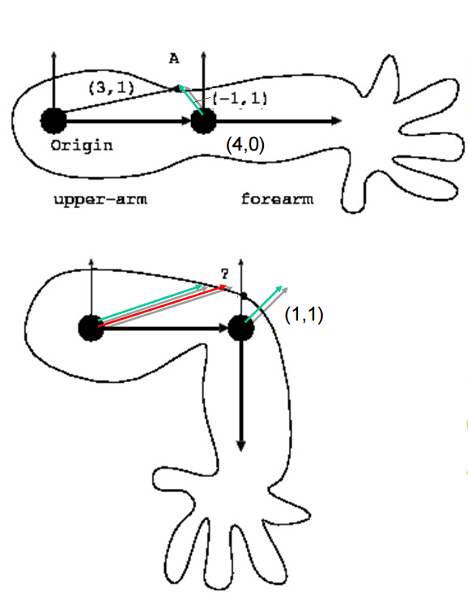
Example
What is the position of point A after the elbow is bent 90 degrees?
Assuming the weight for the upper arm is 0.8 and forearm is 0.2
http://homepages.inf.ed.ac.uk/tkomura/cav/presentation4_2016.pdf

Slide 10
Example
Assuming it is a point of the upper arm, the position is (3,1)
Assuming it is a point of the forearm, it is (5,1)
Adding the weights
0.8*(3,1)+0.2*(5,1) = (3.4, 1)

Slide 11
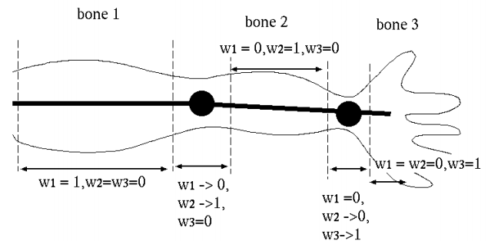
How to decide the weights?
Decide the mapping of the vertex to the bone
http://homepages.inf.ed.ac.uk/tkomura/cav/presentation4_2016.pdf

Slide 12
Rig Data Flow
Input DOFs
Rigging system
(skeleton, skin…)
Output renderable mesh
(vertices, normals…)
Rig

Slide 13
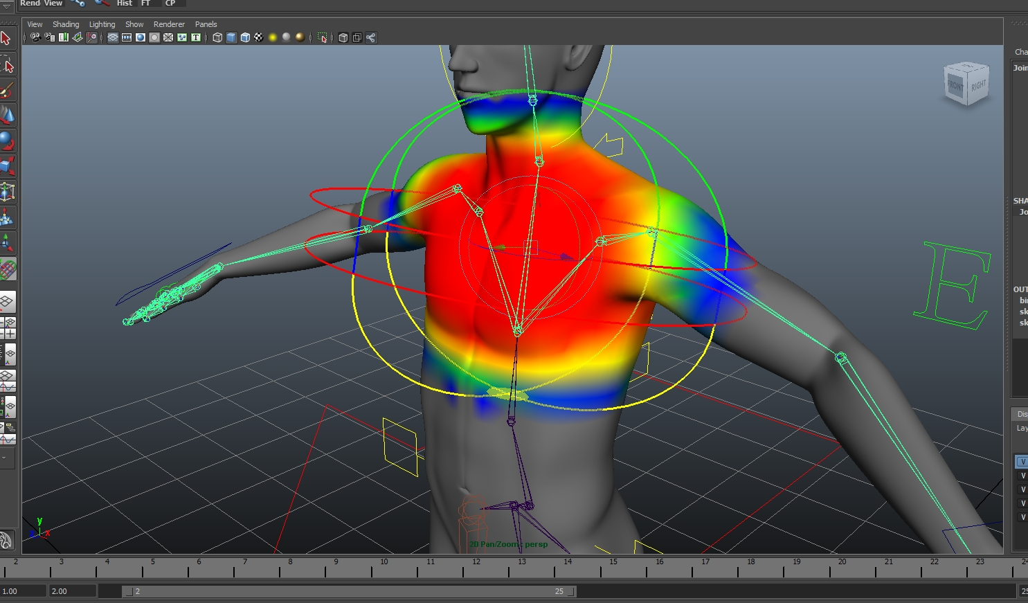
Painting weights
https://www.youtube.com/watch?v=Ah-Jk7d30ks

Slide 14
Algorithm Overview
Skin::Update() (view independent processing)
Compute skinning matrix for each joint: M=B⁻¹·W (you can precompute and store B⁻¹ instead of B)
Loop through vertices and compute blended position & normal
Skin::Draw() (view dependent processing)
Loop through triangles and draw using world space positions & normal

Slide 15
Skinning Equations
Skeleton
Skinning

Slide 16
Limitations of Smooth Skin
Smooth skin is very simple and quite fast, but its quality is limited
The main problems are:
Joints tend to collapse as they bend more
Very difficult to get specific control
Unintuitive and difficult to edit
Still, it is built in to most 3D animation packages
If nothing else, it is a good baseline upon which more complex schemes can be built

Slide 17
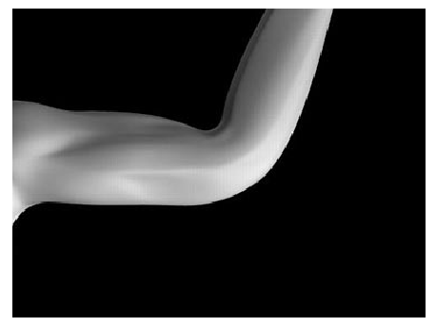
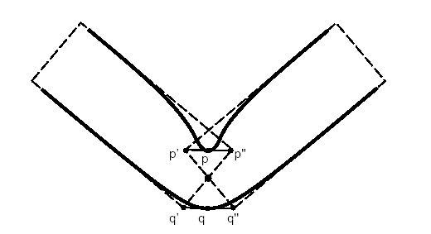
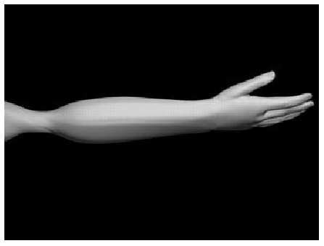
Limitations of Smooth Skin
Skin collapse (bending) and twisting (candy wrapper) effect
Pose Space Deformation: A Unified Approach to Shape Interpolation and Skeleton-Driven Deformation, Lewis, Cordner and Fong, SIGGRAPH 2000

Slide 18
Why does it happen?
http://homepages.inf.ed.ac.uk/tkomura/cav/presentation4_2016.pdf

Slide 19
Why does it happen?

Slide 20
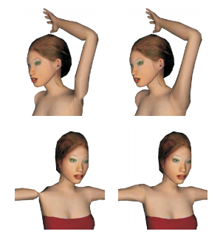
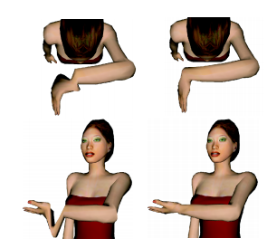
Dual quaternion blending
Proposed to overcome the bending and candy wrapper effects
Currently, found in most 3D modelling tools, e.g. Maya, Blender
Geometric Skinning with Approximate Dual Quaternion Blending, Kavan Collins, Zara and O'Sullivan, Siggraph 2008

Slide 21
Supplementary material
Siggraph course on skinning (2014): https://dl.acm.org/doi/10.1145/2614028.2615427

Slide 22
Shape Interpolation
Another extension to the smooth skinning algorithm is to allow the vertices to be modeled at key values along the joints motion
For an elbow, for example, one could model it straight, then model it fully bent
These shapes are interpolated local to the bones before the skinning is applied

Slide 23
Shape Interpolation Algorithm
To compute a blended vertex position:
The blended position is the base position plus a contribution from each target whose DOF value is greater than 0
To blend the normals, we use a similar equation:
We won’t normalize them now, as that will happen later in the skinning phase

Slide 24
Layered Approach
We use a simple layered approach
Skeleton Kinematics
Shape Interpolation
Smooth Skinning
Most character rigging systems are based on some sort of layered system approach combined with general purpose data flow to allow for customization

Slide 25
Free-Form Deformations
FFDs are a class of deformations where a low detail control mesh is used to deform a higher detail skin
There are a lot of variations on FFDs based on the topology of the control mesh
Thomas W. Sederberg and Scott R. Parry. 1986. Free-form deformation of solid geometric models. In Proceedings of the 13th annual conference on Computer graphics and interactive techniques (SIGGRAPH '86)

Slide 26
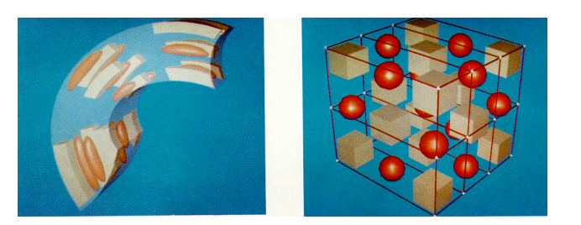
Lattice FFDs
The original type of FFD uses a simple regular lattice placed around a region of space
The lattice is divided up into a regular grid
When the lattice points are then moved, they describe smooth deformation in their vicinity

Slide 27
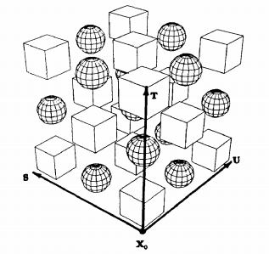
Lattice FFDs
We start by defining the undeformed lattice space:

Slide 28
Lattice FFDs
We then define the number of sections in the 3 lattice dimensions:
1 <= l,m,n <= 3
And then set the initial lattice positions: p_{ijk}

Slide 29
Lattice FFDs
To deform a point x, we first find the (s,t,u) coordinates:
Then deform that into world space (similar to Bezier curves and Bernstein polynomials) :

Slide 30
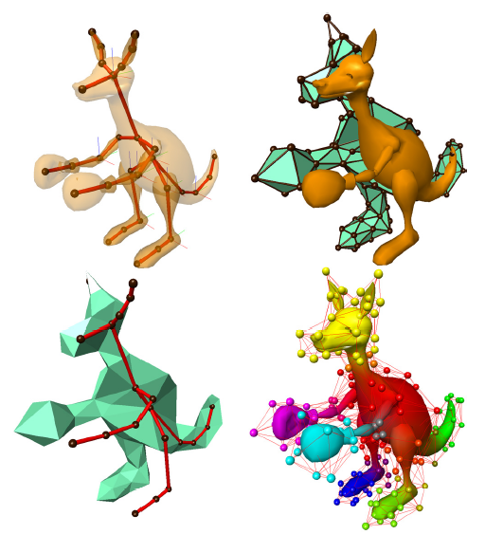
Arbitrary Topology FFDs
The concept of FFDs was later extended to allow an arbitrary topology control volume to be used
Steve Capell, Seth Green, Brian Curless, Tom Duchamp, and Zoran Popović. 2002. Interactive skeleton-driven dynamic deformations. In Proceedings of the 29th annual conference on Computer graphics and interactive techniques (SIGGRAPH '02).

Slide 31
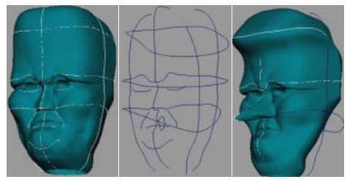
Axial Deformations & WIRES
Another type of deformation allows the user to place lines or curves within a skin
When the lines or curves are moved, they distort the space around them
Multiple lines & curves can be placed near each other and will properly interact
Karan Singh and Eugene Fiume. 1998. Wires: a geometric deformation technique. In Proceedings of the 25th annual conference on Computer graphics and interactive techniques (SIGGRAPH '98).

Slide 32
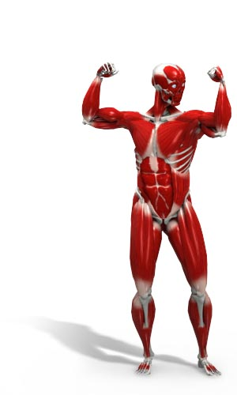
Anatomical Modeling
The motion of the skin is based on the motion of the underlying muscle and bones. Therefore, in an anatomical simulation, the tissue beneath the skin must be accounted for
One can model the bones, muscle, and skin tissue as deformable bodies and then use physical simulation to compute their motion
Various approaches exist ranging from simple approximations using basic primitives to detailed anatomical simulations

Slide 33
Skin & Muscle Simulation
Bones are essentially rigid
Muscles occupy almost all of the space between bone & skin
Although they can change shape, muscles have essentially constant volume
The rest of the space between the bone & skin is filled with fat & connective tissues
Skin is connected to fatty tissue and can usually slide freely over muscle
Skin is anisotropic as wrinkles tend to have specific orientations

Slide 34
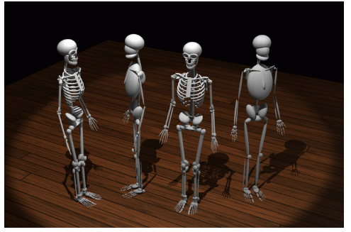
Simple Anatomical Models
Some simplified anatomical models use ellipsoids to model bones and muscles
Ferdi Scheepers, Richard E. Parent, Wayne E. Carlson, and Stephen F. May. 1997. Anatomy-based modeling of the human musculature. In Proceedings of the 24th annual conference on Computer graphics and interactive techniques (SIGGRAPH '97)

Slide 35
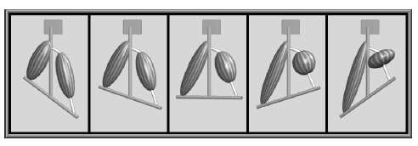
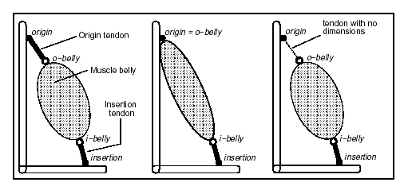
Simple Anatomical Models
Muscles are attached to bones, sometimes with tendons as well
The muscles contract in a volume preserving way, thus getting wider as they get shorter

Slide 36
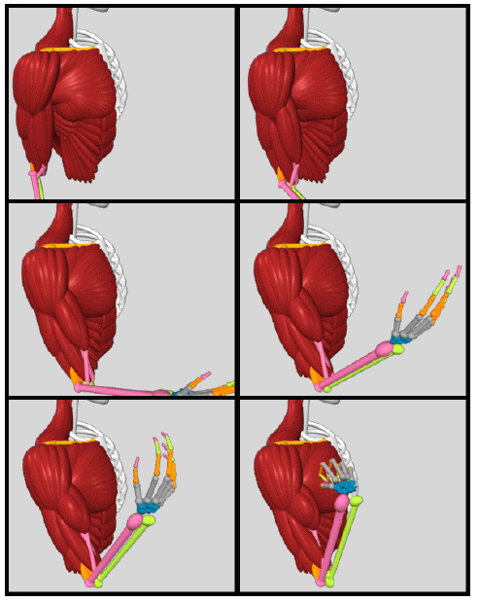
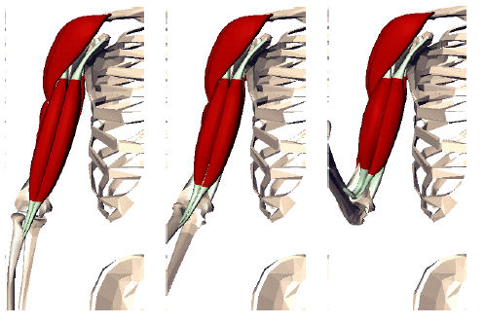
Simple Anatomical Models
Complex musculature can be built up from lots of simple primitives

Slide 37
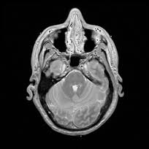
Detailed Anatomical Models
One can also do detailed simulations that accurately model bone & muscle geometry, as well as physical properties
e.g. Visible Human Project
https://en.wikipedia.org/wiki/Visible_Human_Project

Slide 38
Body Scanning
Data input has become an important issue for the various types of data used in computer graphics
Examples:
Geometry: Laser scanners
Motion: Optical motion capture
Faces: Computer vision
Recently, people have been researching techniques for directly scanning human bodies and skin deformations

Slide 39
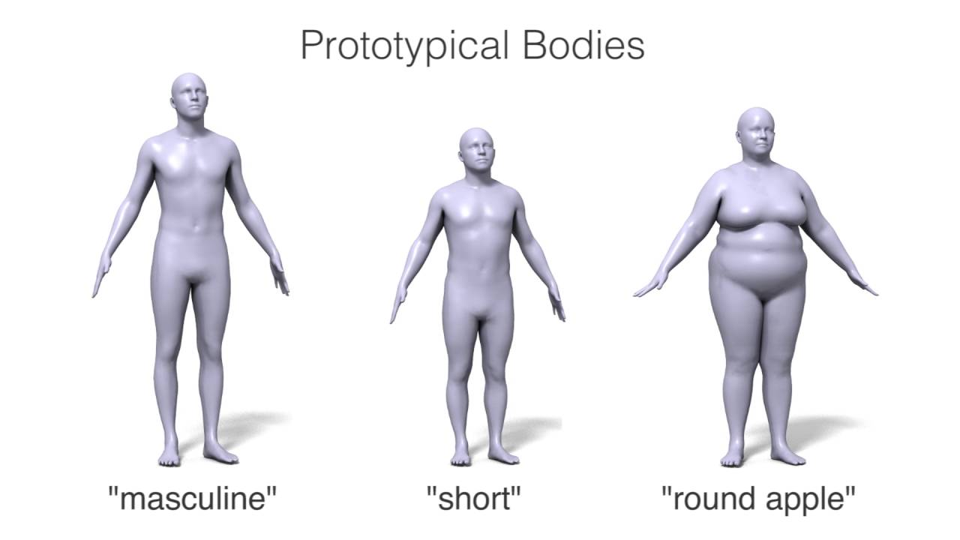
Body Scanning
Practical approaches tend to use either a 3D model scanner (like a laser) or a 2D image based approach (computer vision)
The skin is scanned at various key poses and some sort of 3D model is constructed
Some techniques attempt to fit this back onto a standardized mesh, so that all poses share the same topology. This is difficult, but it makes the interpolation process much easier.
Other techniques interpolate between different topologies. This is difficult also.
http://graphics.cs.cmu.edu/projects/muscle/
http://dyna.is.tue.mpg.de/
Siggraph course on “Learning body shapes in motion”, 2016
https://dl.acm.org/doi/10.1145/2897826.2927326

Slide 40
References/Supplementary Material
Siggraph course on skinning (2014): https://dl.acm.org/doi/10.1145/2614028.2615427
Siggraph course on “Learning body shapes in motion”, 2016
https://dl.acm.org/doi/10.1145/2897826.2927326
Some of the slides of this lecture are based on the Computer Animation course at the University of California San Diego.

